Slide 1
Financial Analysis
Lucky Suman

Slide 2
Business Understanding & Overview
We have a data set containing ABC company’s financial data financial data which has various data of accounts and also has the data of income and money paid to those accounts. We will use Exploratory Data Analysis in order to get actionable insights and important KPI’s convert them into meaningful story.

Slide 3
Understanding the data

Slide 4
Dataset
We have dataset in excel format wherein there are 3 different worksheets i.e. Chart of Accounts, Payments and Income.
Using Python, we are converting the worksheets into 3 data frames and then merging these data frames to one main data frame using join on chart account ID as it is unique and non- null.

Slide 5
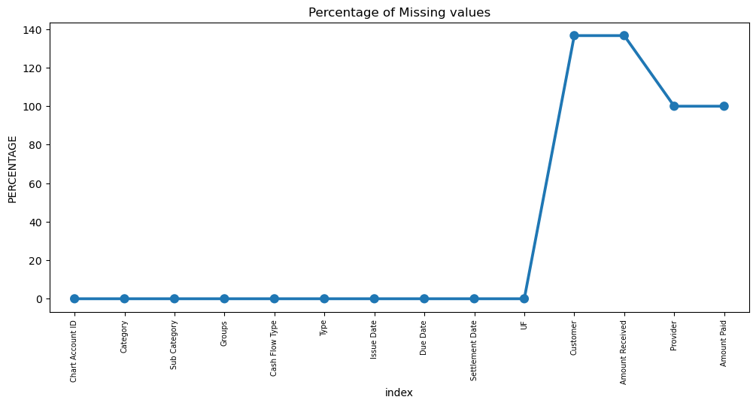
Initial Intuition and Missing Data
After merging we will have some missing values

Slide 6
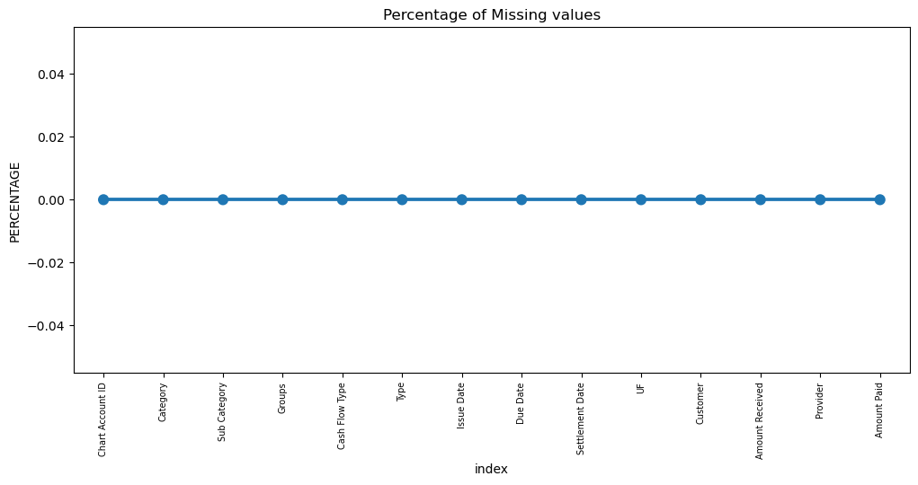
Missing value treatment
We are imputing in place of missing values as the amount received column for cash out flow category will be 0 and amount paid column for cash in flow category will be 0.

Slide 7
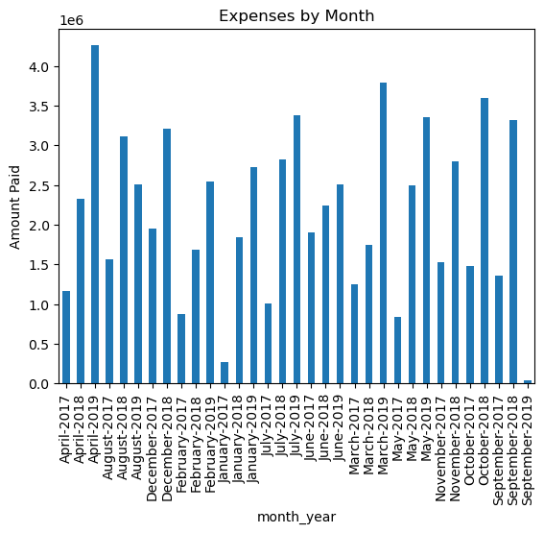
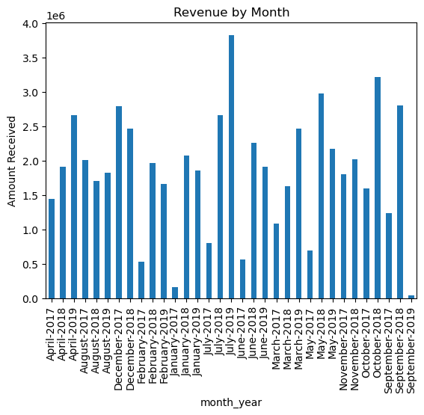
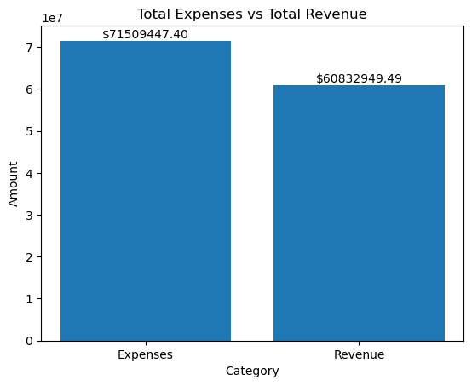
Total revenue generated by company is 60832949.49 and the total expenses incurred by company are 71509447.39.
In July 2019, highest revenue was generated, and January 2017 is the least revenue generated month
3.Expenses incurred in April 2019 are highest and least expenses were incurred in January 2017.

Slide 8
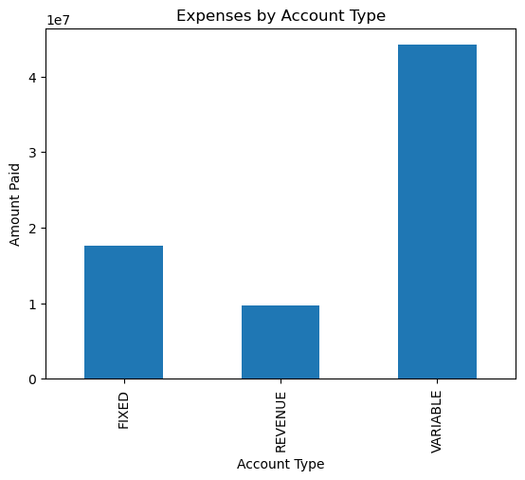
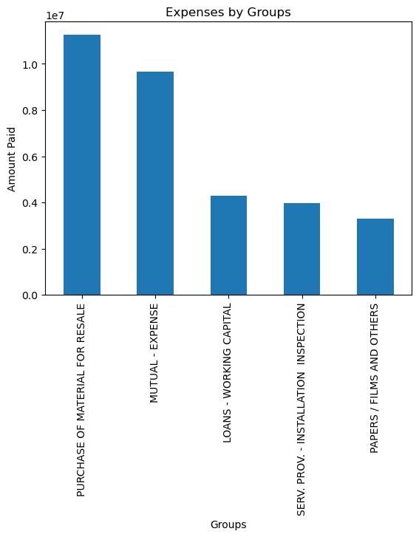
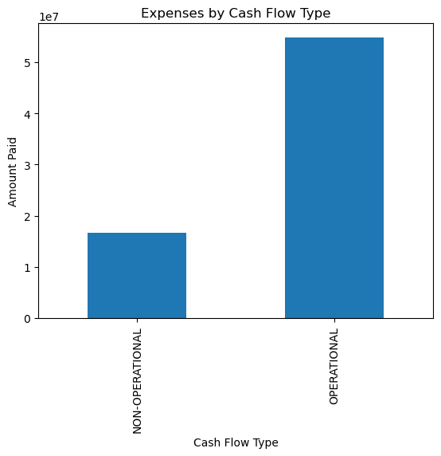
Expenses in variable accounts are the highest.
Operational expenses are more than non operational expenses.
Expenses incurred on Purchase of Material for resale are highest.

Slide 9
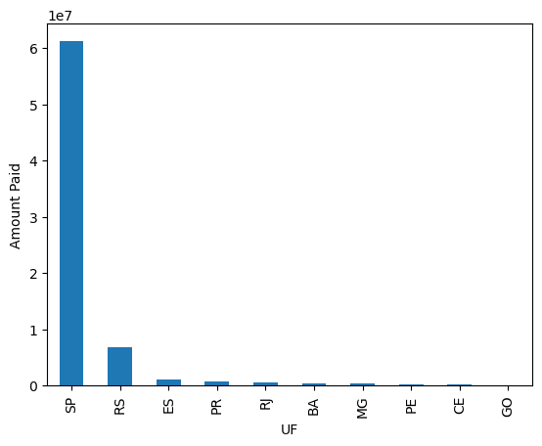
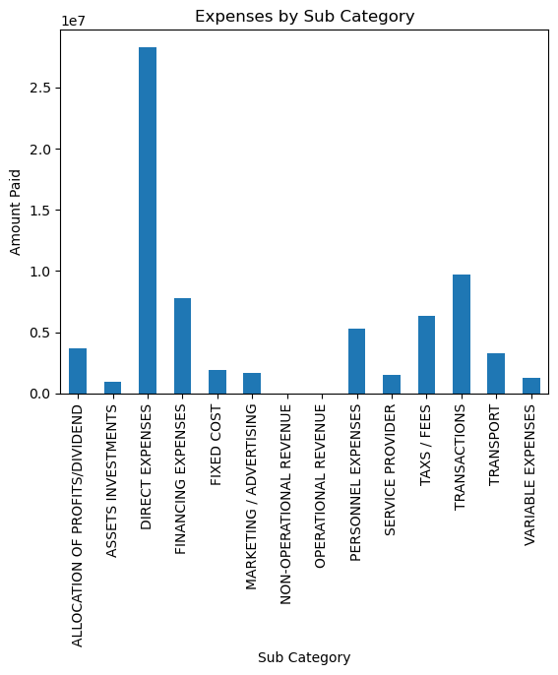
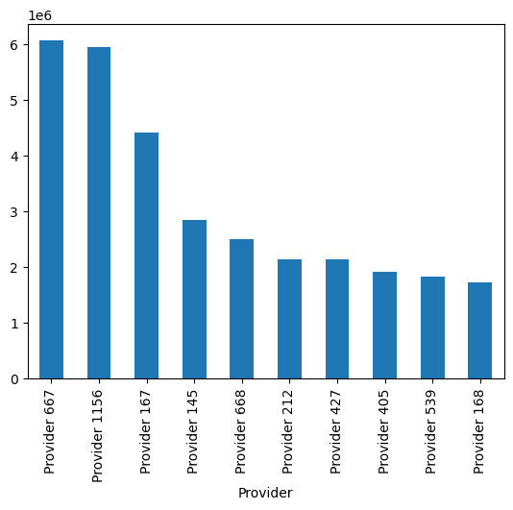
Direct expenses are highest than other expenses.
Amount paid in SP(UF) is the highest.
Provider 667 is the top provider.

Slide 10
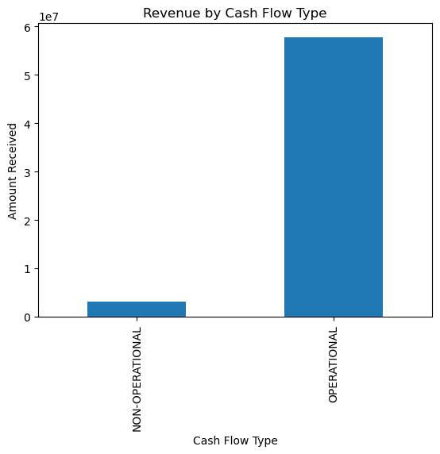
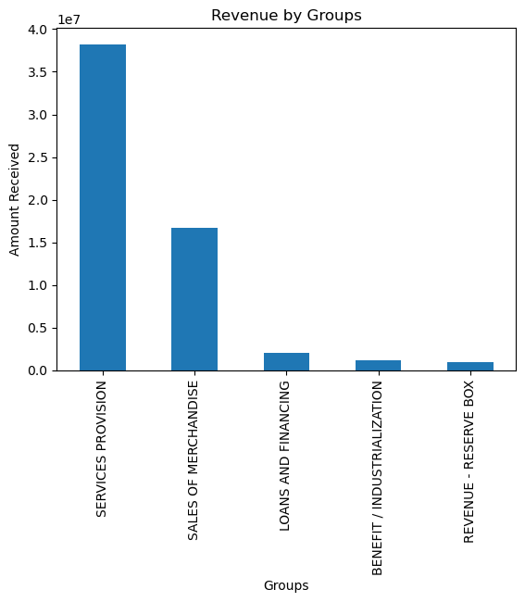
Operational Revenue is more than non-operational revenue
Revenue in Services Provision group is highest.

Slide 11
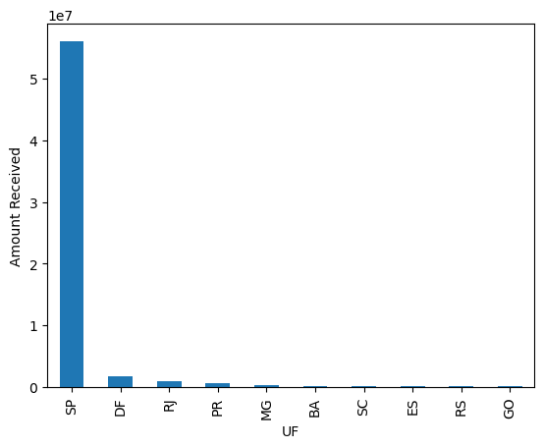
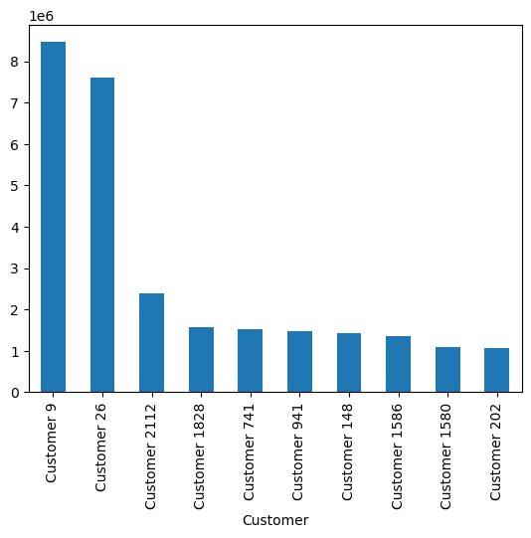
Amount received in SP(UF) is the highest.
Customer 9 is the top customer.

Slide 12
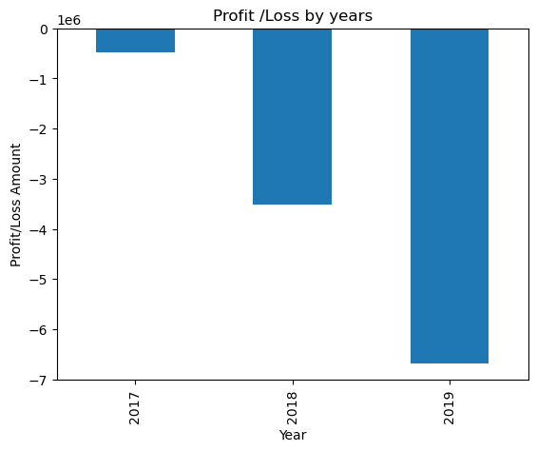
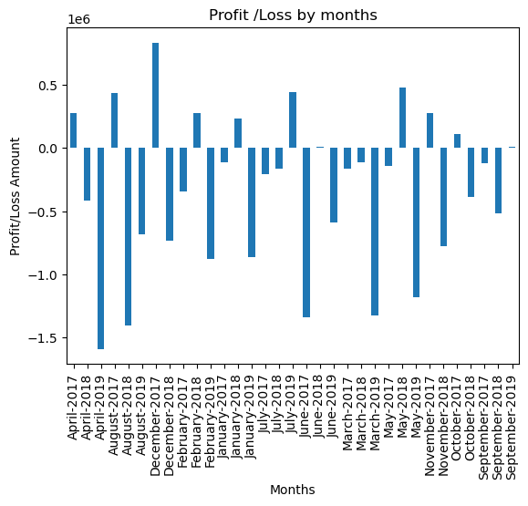
Net income is -10.68 M. The company is in continuous loss from 2017 to 2019. Highest loss is in 2019.
Highest Net Income Month: December 2017 ($0.83 M) and Lowest Net Income Month: April 2019(-$1.5 M).

Slide 13
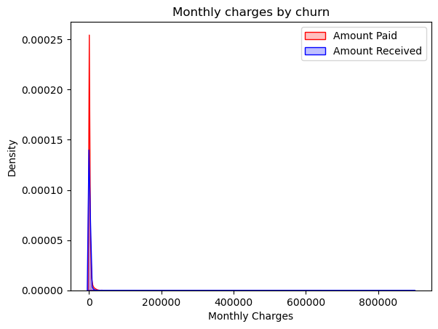
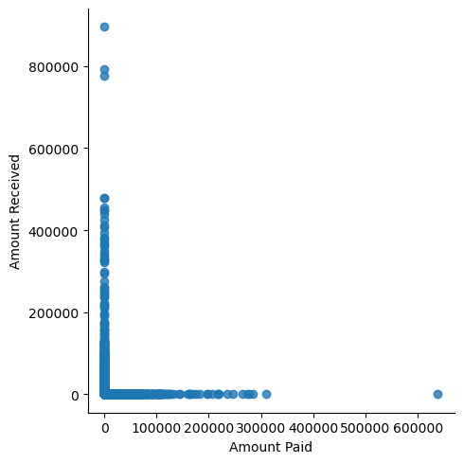
The correlation coefficient value of -0.02543900670349728 suggests a very weak negative correlation. This means that as one variable increases, the other variable tends to decrease slightly, but the relationship is not strong. So we can say no correlation between Amount paid and amount received.

Slide 14
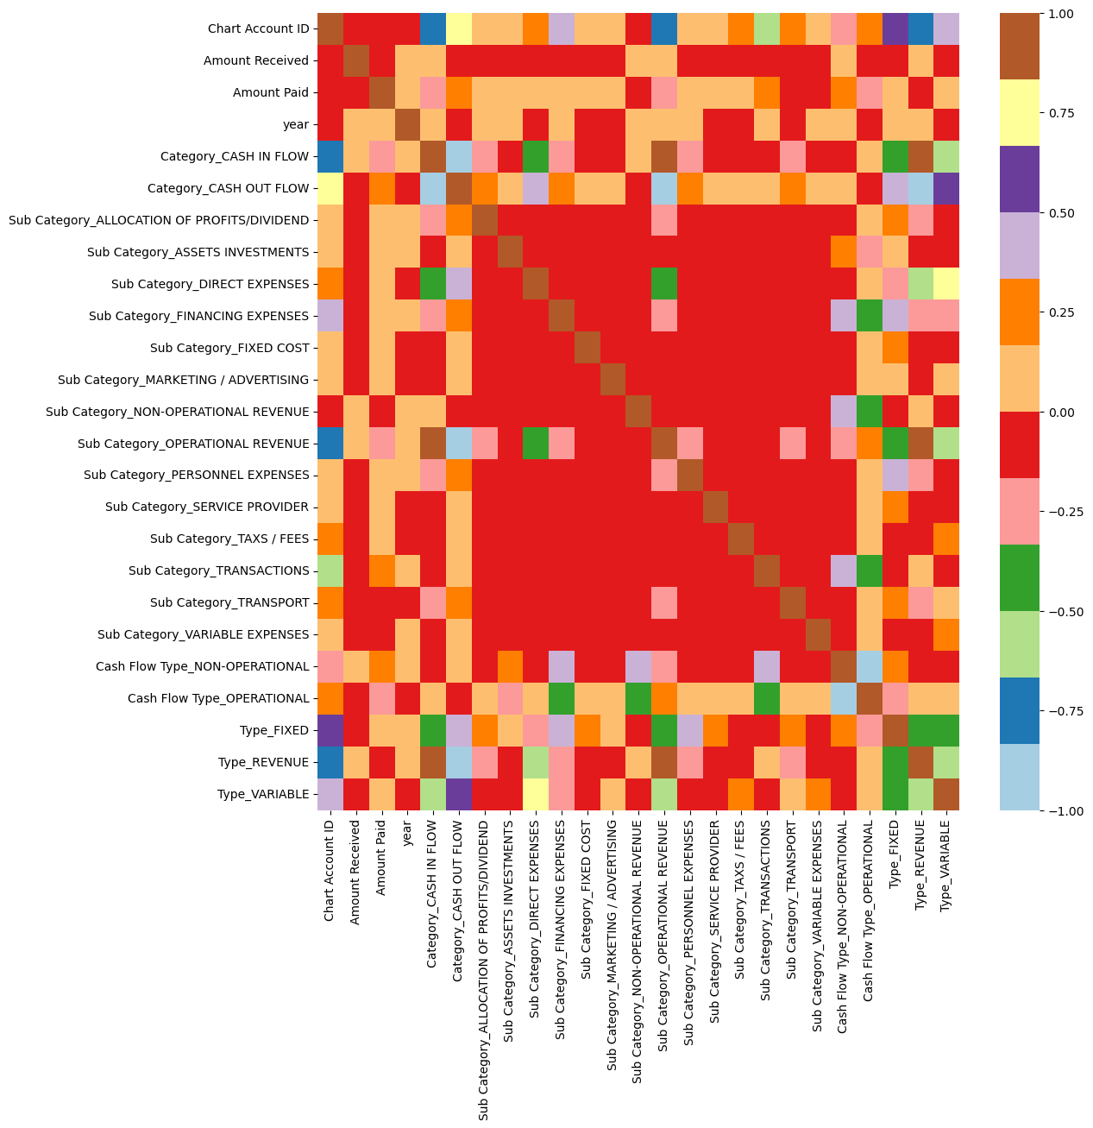

Slide 15
Final Thoughts
Total revenue generated by company is 60832949.49 and the total expenses incurred by company are 71509447.39.
In July 2019, highest revenue was generated, and January 2017 is the least revenue generated month.
3. Expenses incurred in April 2019 are highest and least expenses were incurred in January 2017.
4. Expenses in variable accounts are the highest.
5. Operational expenses are more than non operational expenses.
6. Expenses incurred on Purchase of Material for resale are highest.
7. Direct expenses are highest than other expenses.
8. Amount paid in SP(UF) is the highest.
9. Provider 667 is the top provider and Customer 9 is the top customer.
10. Operational Revenue is more than non-operational revenue
11. Revenue in Services Provision group is highest.
12. 13. Net income is -10.68 M. The company is in continuous loss from 2017 to 2019. Highest loss is in 2019.
14. Highest Net Income Month: December 2017 ($0.83 M) and Lowest Net Income Month: April 2019(-$1.5 M).
Amount received in SP(UF) is the highest.

Slide 16
Thank you

